Slide 1
Programming

Slide 2
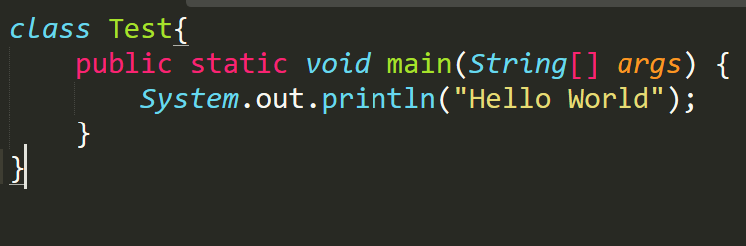
Hello world Java

Slide 3
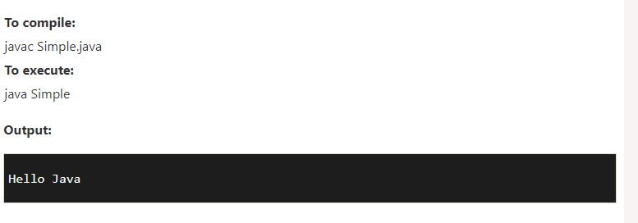

Slide 4
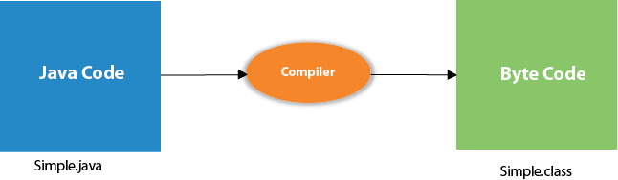
Compilation flow

Slide 5
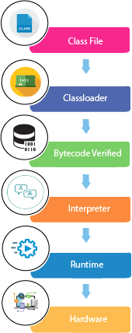
Description
Hello.class file will be loaded to JVM by the ClassLoader. Where the ClassLoader is the subsystem of JVM that is used to load class file.
ByteCode Verifier : Checks the code fragments for illegal code that can violate access rights to objects.
Interpreter : Read bytecode stream then execute the instruction

Slide 6
Can You save a Java source file by another name than the class name?

Slide 7
Can you have multiple classes in a java source file?

Slide 8

Java and internet
Java has strong relation with internet
Where java applet made it the world most popular language
Where people/developer can make java applet and run it into Java enabled browser
Or upload them into the web and let other people download it and run it in the remote server
Else develop an applet and upload it into internet and other people can use that applet

Slide 9

Java and World Wide Web
Web system is open-end and we can navigate to a new document in any direction which made possible with HTML
Where Java is meant to be used in a distributed environment such as internet. Hence it was easily incorporate into the web system
Before Java the web is capable of only serving still image and text
By incorporating the java with web, it empower the web with capable of serving animation, graphic, games and a wide range of special effects.

Slide 10
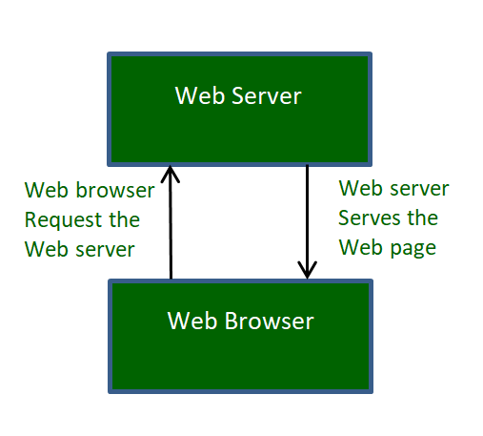
Web Browser
They are used to navigate through the information found on the net.
Where browser understand different language such as HTML, CSS and JavaScript etc.
Hot Java is a web browser that was entirely written in Java language from sun microsystem

Slide 11
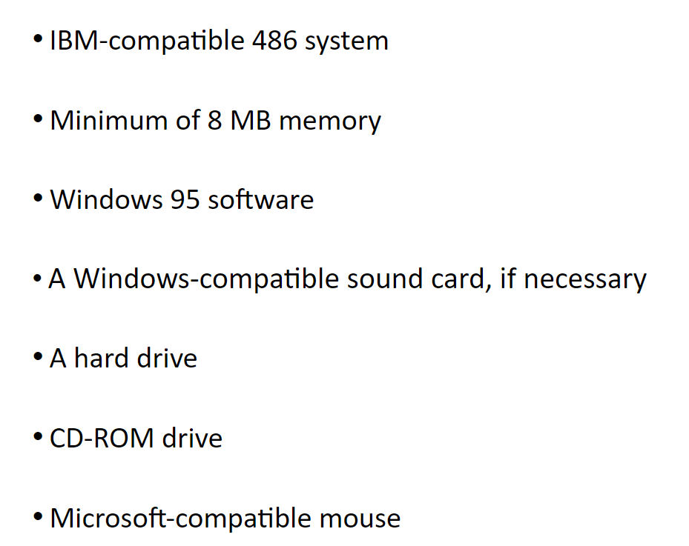
Hardware and software requirement

Slide 12
Java Virtual Machine
It is an abstract machine. It is a specification that provides runtime environment in which java bytecode can be executed.
JVM are available for many hardware and software platforms (i.e., JVM is platform dependent)
JVM, JRE, and JDK are platform dependent because the configuration of each OS is different from each other. However, Java is platform independent.

Slide 13
Continuous
A specification were working of Java Virtual Machine is specified. But implementation provider is independent to choose the algorithm. Its implementation has been provided by Oracle and other companies.
An implementation Its implementation is known as JRE (Java Runtime Environment)
Runtime Instance whenever you write java command on the command prompts to run the java class, an instance of JVM is created.

